Slide 1

Project 7:
Used Bike Price Analysis
By: Umesh Uday Salvi
UNID: 2025045

Slide 2
Project Overview
Objective: Predict used bike prices using data analysis and ML
Domain: Financial Analysis
Tools: Python, Jupyter Notebook, Pandas, Matplotlib, Seaborn, Sklearn
Target Variable: Price (in INR)

Slide 3
Data Cleaning
Handled missing values in mileage, power, location, etc.
Corrected inconsistent brand/ model names.
Extracted CC and brand from model_name column.
Created new features: cc, brand, age of bike
Processed mileage, power, and kms_driven columns

Slide 4
Exploratory Data Analysis (EDA)
Analysed price distribution and trends by year, brand, owner type
Prices varies significantly by cc, power, and mileage
Most bikes are 150cc or 350cc, 1st Owner, from brands like Bajaj and Yamaha

Slide 5
Data Visualization
Bar Charts: Year, Brand, Owner, CC
Histograms: Mileage, Power, Price
Boxplots: Price by Owner, Brand, CC

Slide 6
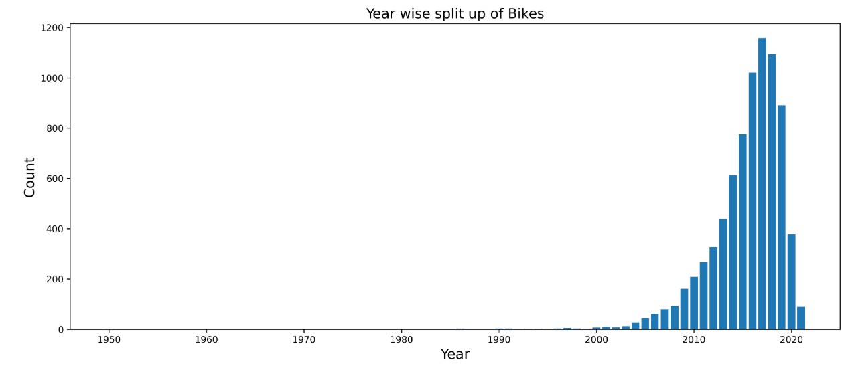
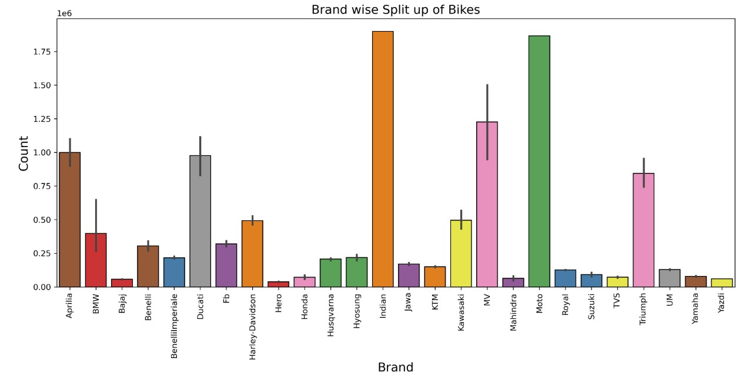
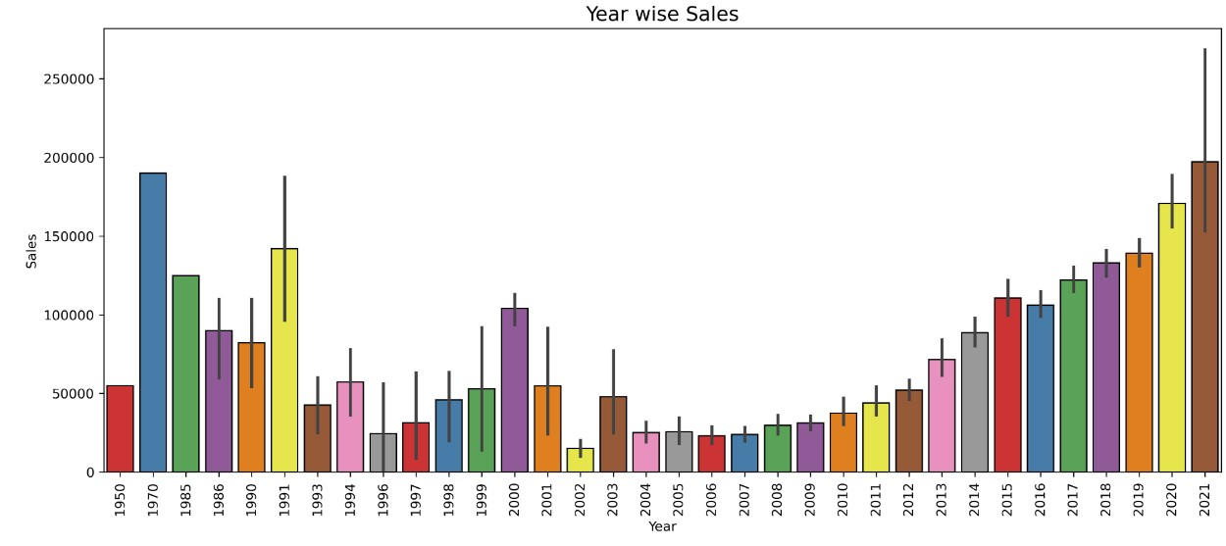
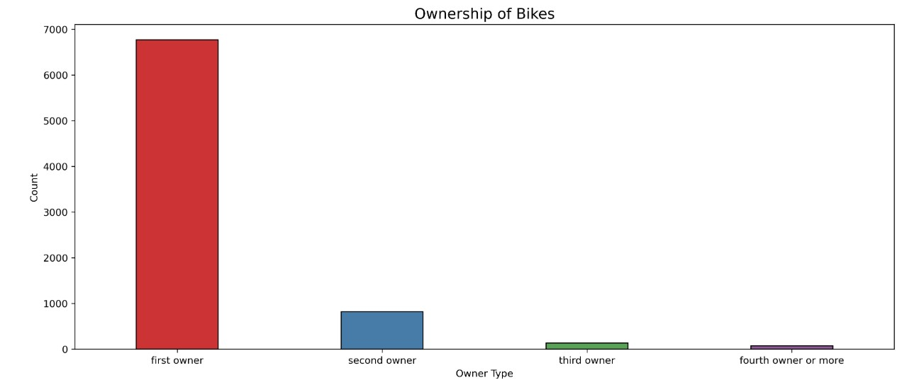
Data Visualization

Slide 7
Model Evaluation
Model used: Linear Regression, Random Forest
Metrics: Mean Squared Error (MSE), R² Score
Top price influencers: model_year, mileage, power, cc
Predictions support pricing decisions for buyers and dealers

Slide 8
Conclusion
Effective use of feature engineering and EDA for price prediction
Future Improvements: Time-based price trends
Ensure robust preprocessing and documentation for deployment

